Slide 1


COMPREHENSIVE DIGITAL MARKETING
PROJECT WORK
ON
MCCAIN FOODS
TEAM MEMBERS :
M. SANDEEP
M. JYOTHSNA
P. JHANAVI DEVI PRIYA
M. DEEPTHI
S. VASU

Slide 2
INDEX
PART 1: BRAND STUDY, COMPETITOR ANALYSIS BUYER’S PERSONA
PART 2: SEO & KEYWORD RESEARCH
PART 3: CONTENT IDEAS AND MARKETING STRATEGIES
PART 4: CONTENT CREATION AND CURATION

Slide 3

PART 1 : BRAND STUDY, COMPETITOR ANALYSIS & AUDIENCE’S PERSONA

Slide 4
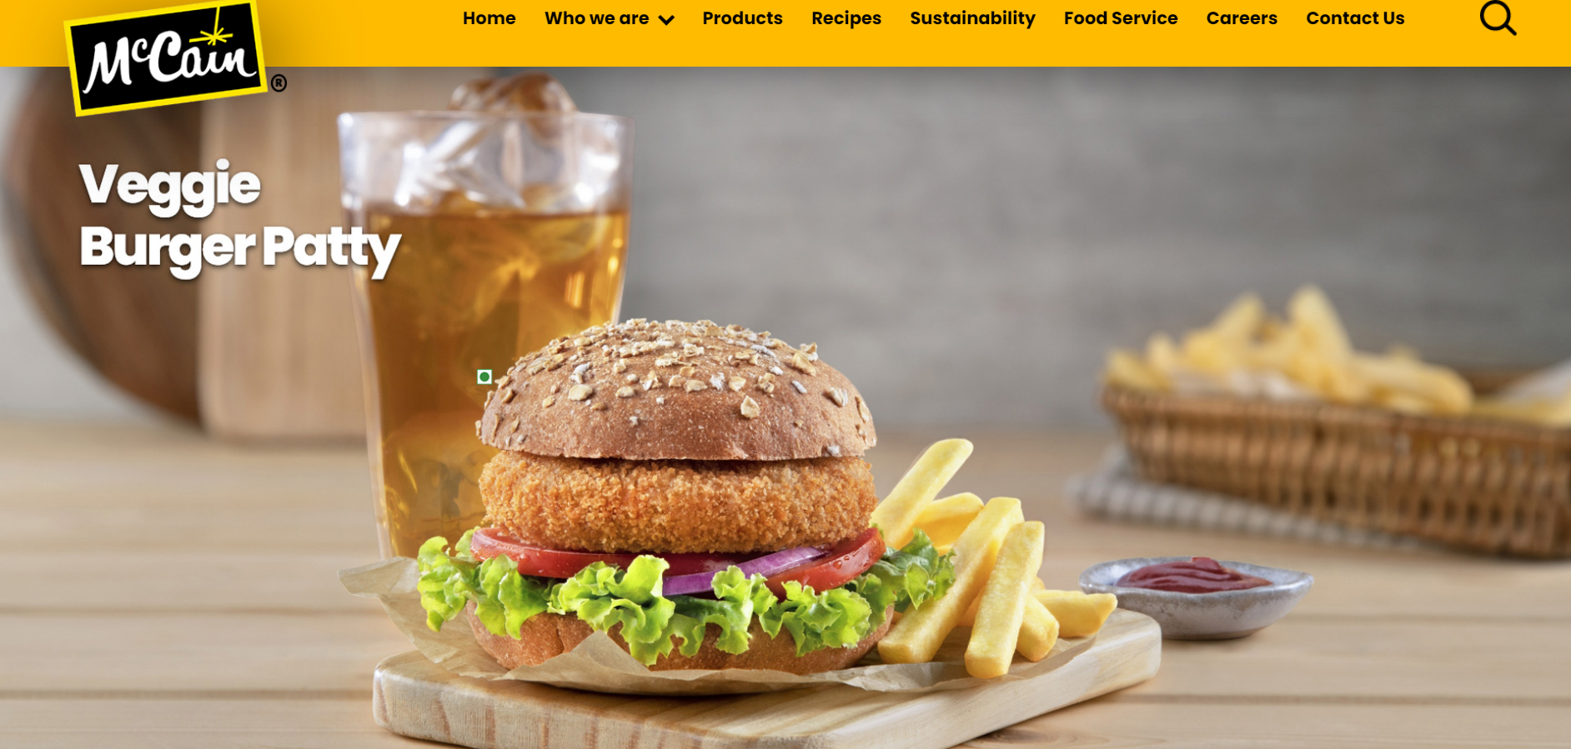
BRAND STUDY :
TOPIC FOR PROJECT : MCCAIN : https://www.mccain.com/
BRAND COLORS :
Yellow 🟡 , White ⚪, Black⚫.

Slide 5


LOGO :
( 1957 – NOW ) ( 2013 – 2018 )
MISSION/VALUES:
McCain’s vision and mission is to 'Celebrating real connections through delicious, planet-friendly food .
USP : https://www.mccain.com/
The USP of McCain is providing content that helps and guides clients to make the best selection for their frozen foods and appetizers with all round sales .

Slide 6
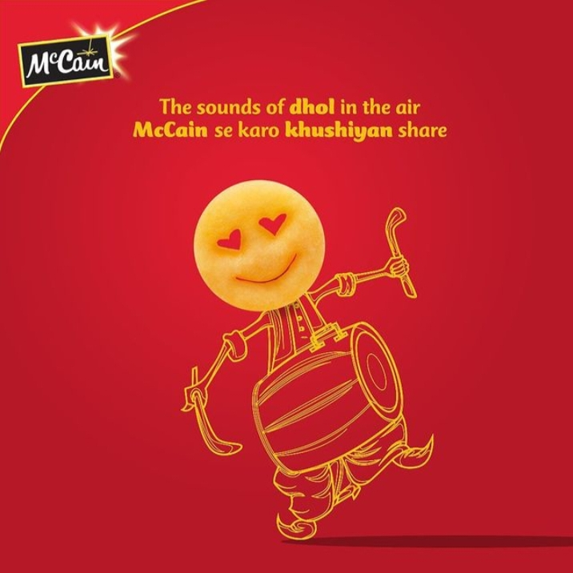
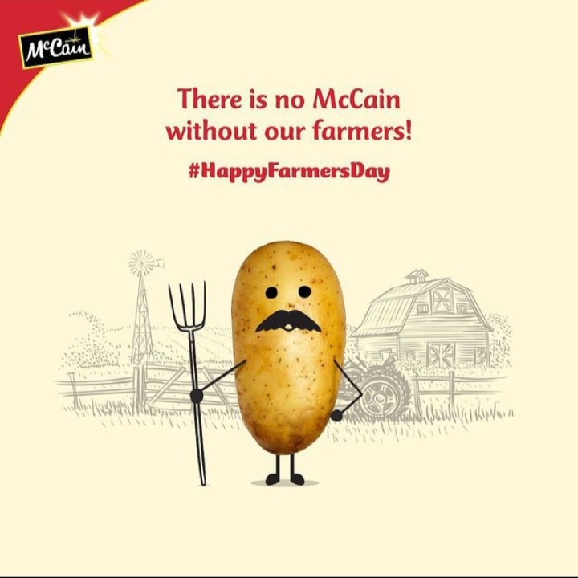
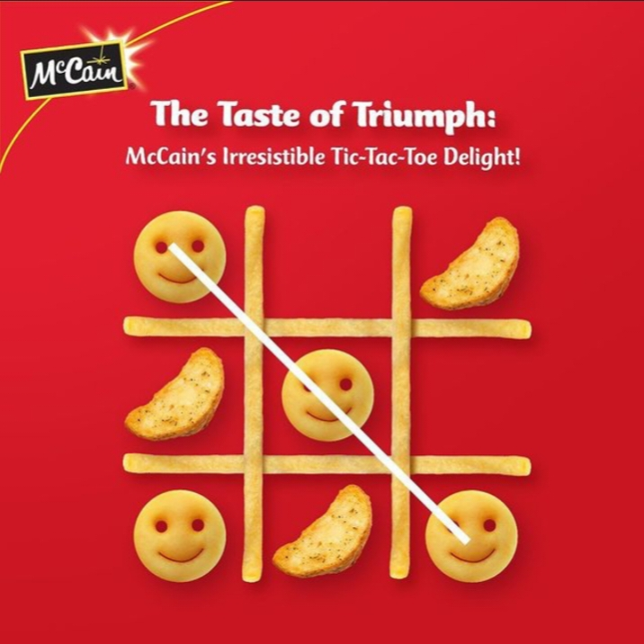
TAGLINE : Making a difference to today, tomorrow and for generations to come.
BRAND MESSAGING :
Informative , fun and friendly
EXAMPLES : https://instagram.com/mccainfoods_india?igshid=MzRlODBiNWFlZA

Slide 7
COMPETITOR ANALYSIS:
COMPETITOR 1 : AMUL : https://www.amul.com/
COMPETITOR 2 : BIKAJI : https://www.bikaji.com/
COMPETITOR 3 : TATA Q : https://www.tata.com/

Slide 8
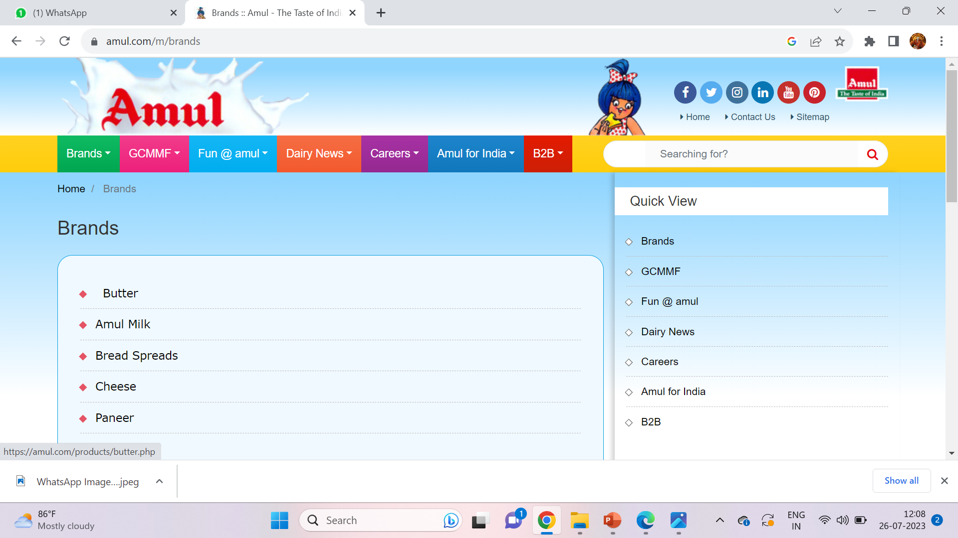
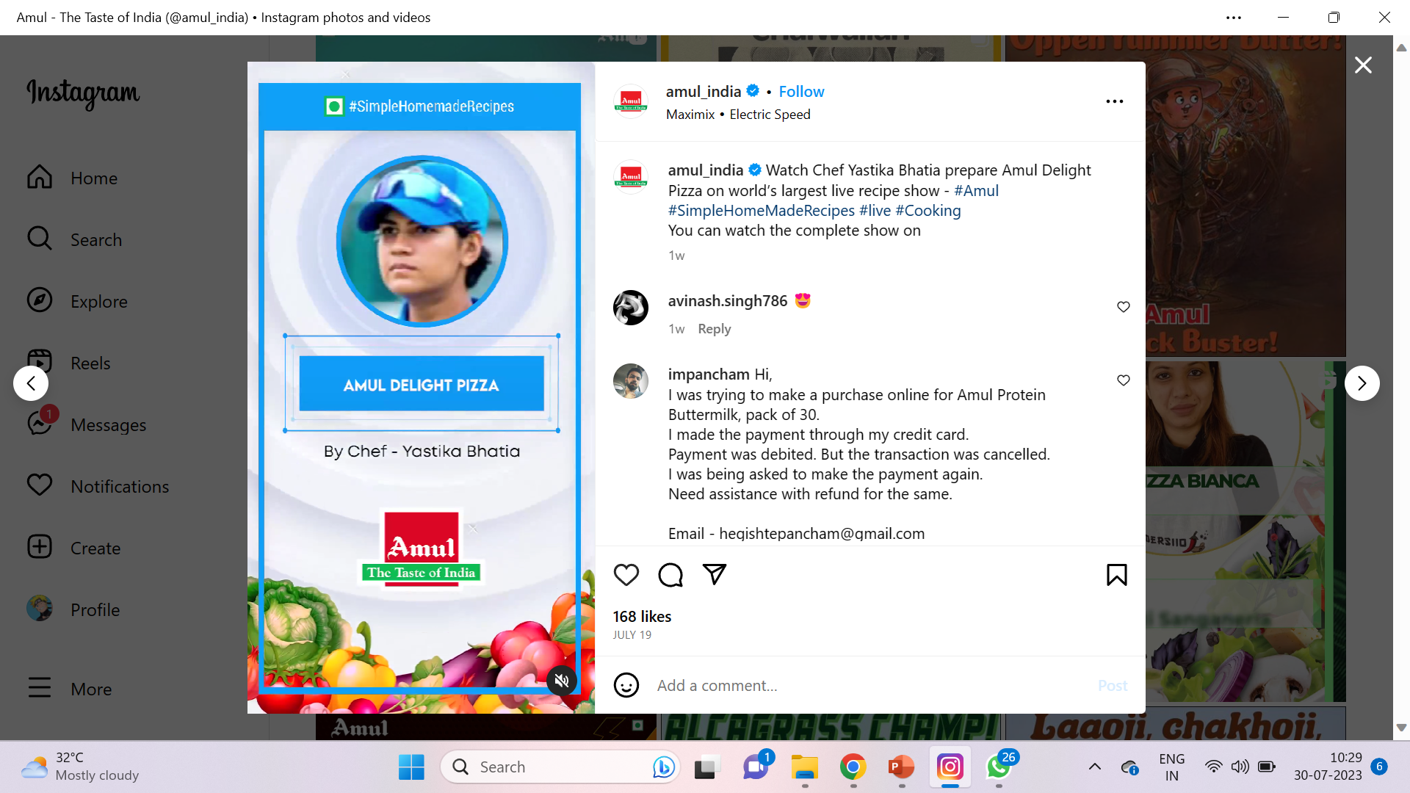
COMPETITOR 1 : AMUL : https://www.amul.com/
USP : Wide variety of food products , All round sale , Categorization .
COMMUNICATION : Celebrity Endorsement , Content memes , Lots of tutorials by experienced chefs

Slide 9
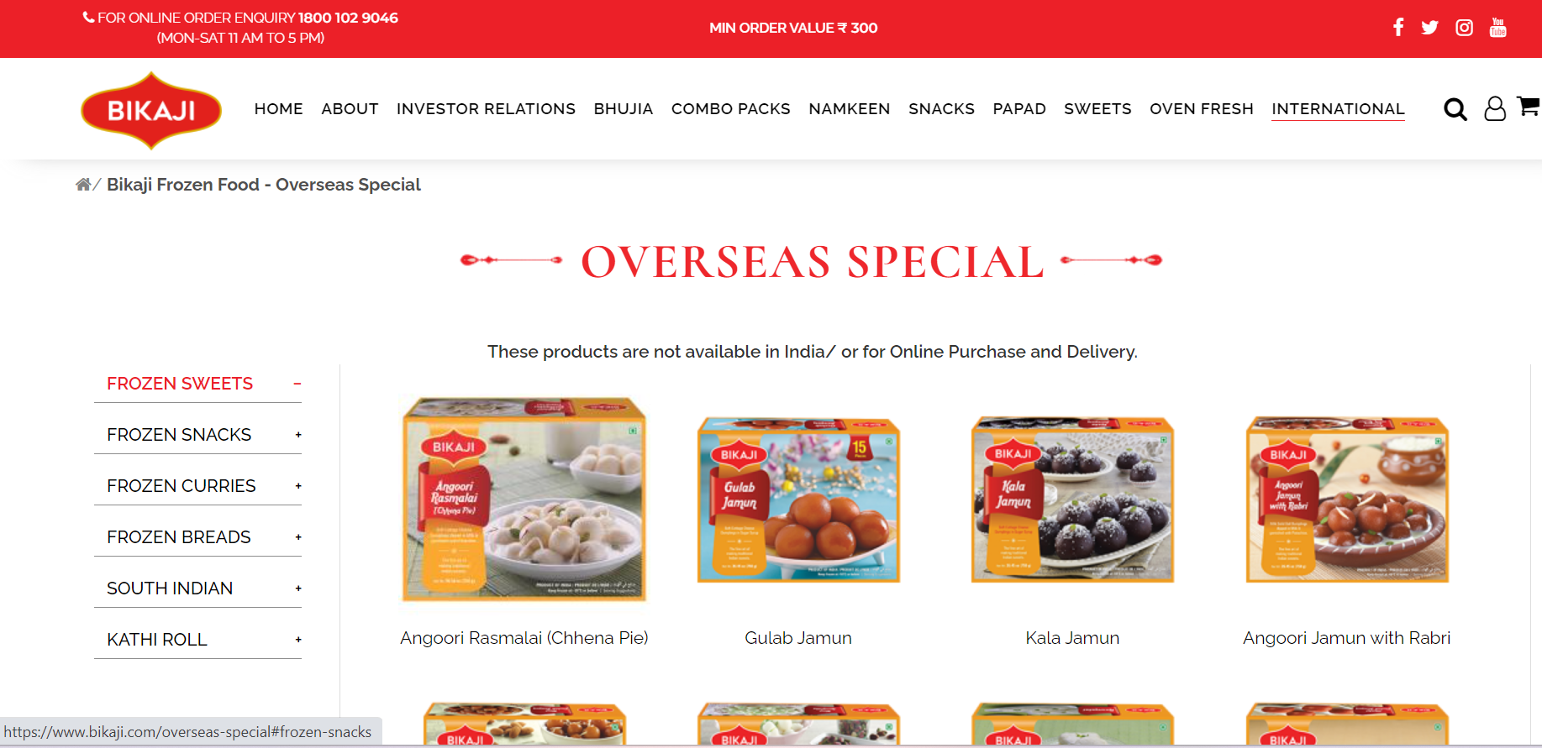
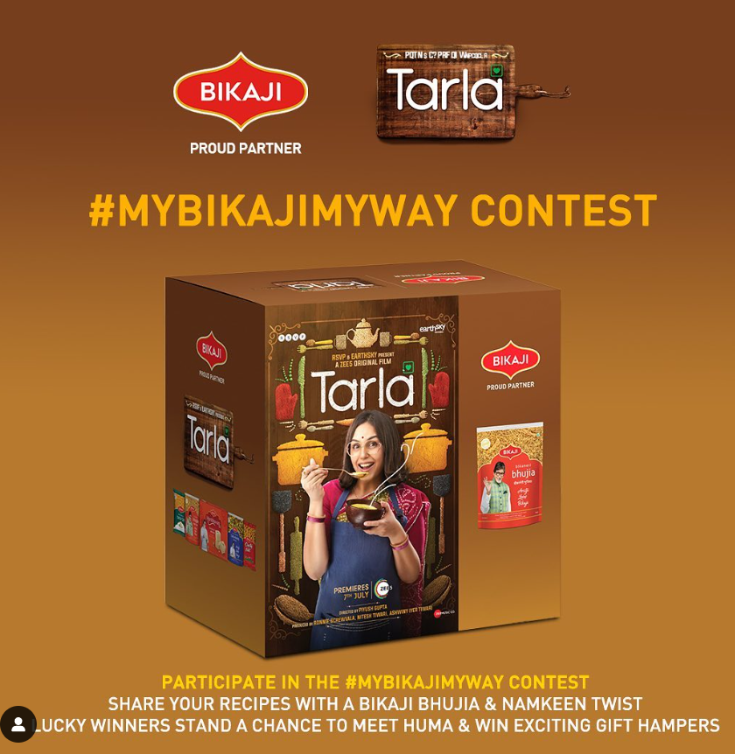
COMPETITOR 2 : BIKAJI : https://www.bikaji.com/
USP : Categorisation ,Refund payment available , All round sale.
Communication : Movie collaborations , Friendly and funny content , Lucky winner challenges ,Celebrity endorsement .

Slide 10
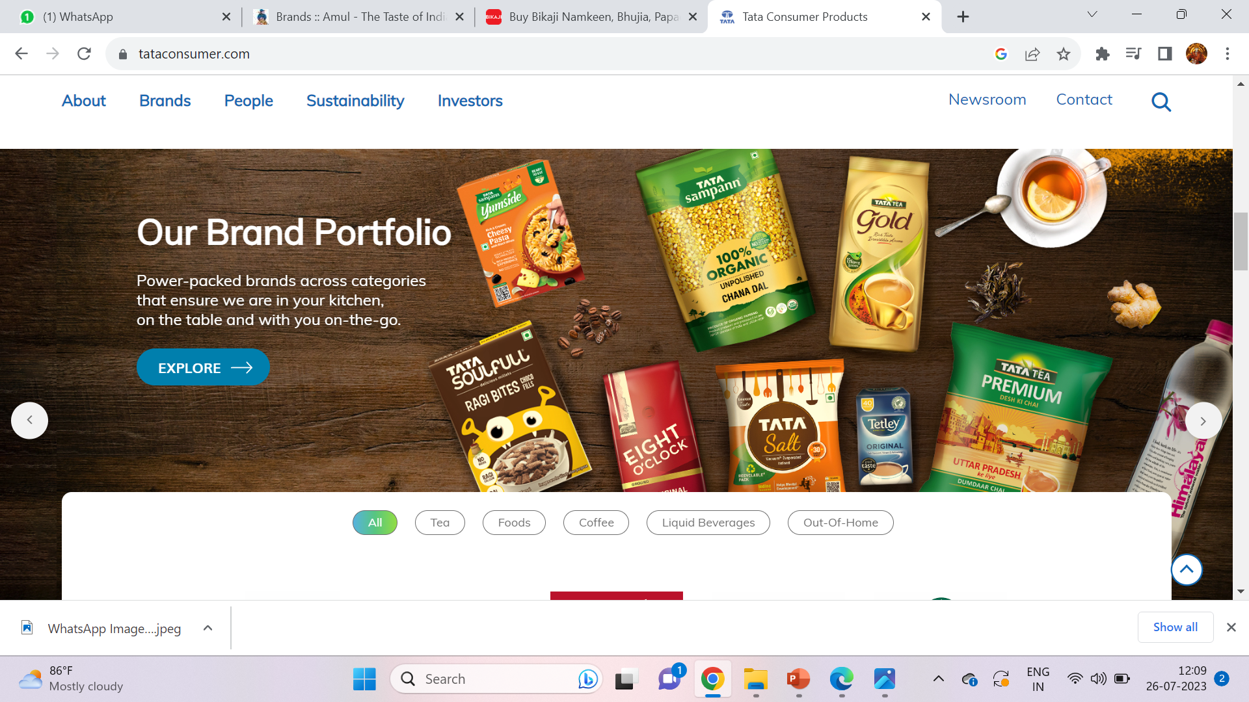
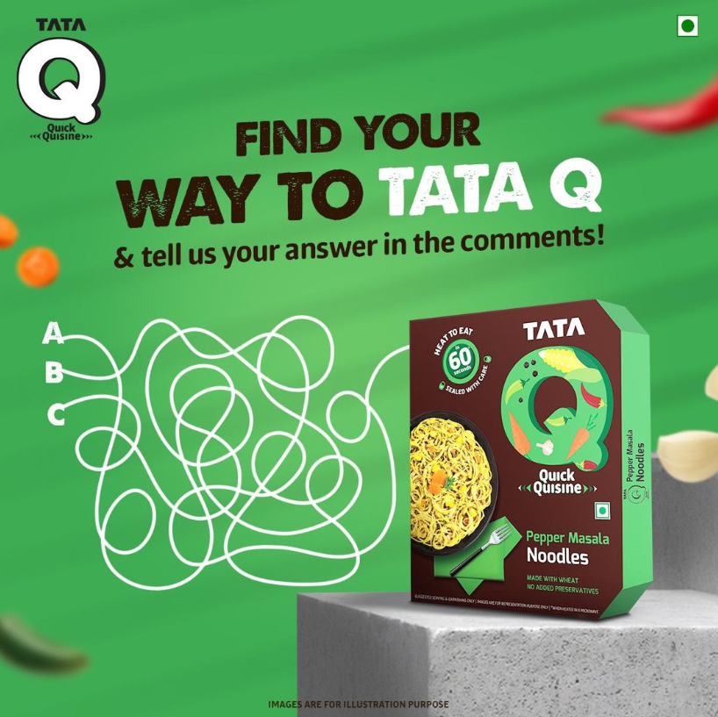
COMPETITOR 3 : TATA Q : https://www.tata.com/
USP : Wide range of veg and non-veg products , All round sales
Communication : Content memes, Funny games ,Quizzes .

Slide 11

BUYER’S PERSONA:
Age : 15 - 55
Gender : All
Children : Yes
Martial Status : Married/Unmarried
Location : Urban/Rural / /Metro cities
Income : 50,000 – 20,00,000 (per annum)
Education : Not specified
Interests : Must enjoy delicious and Prefer healthy food
Marketing platforms : Online ads , Instagram , Television ads , Facebook , Twitter , YouTube

Slide 12
PART 2 : SEO & KEYWORD RESEARCH

Slide 13
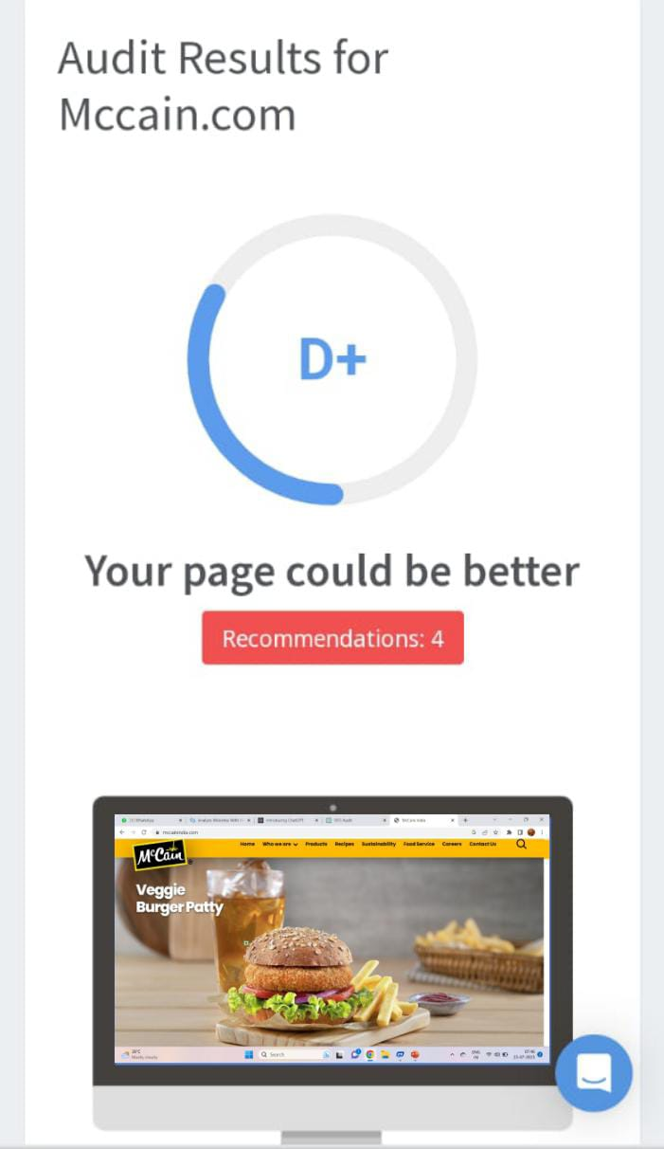
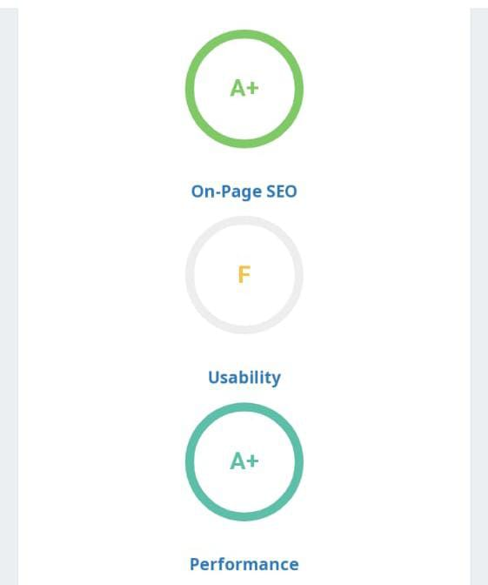
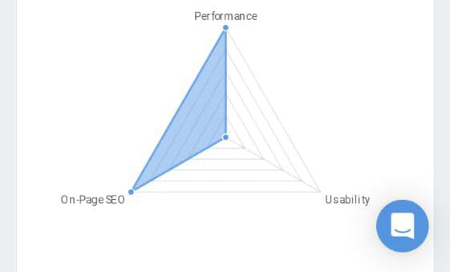
SEO AUDIT :
The main purpose of an search engine optimization (SEO) audit is to identify strengths, weaknesses, and opportunities for improvement to enhance a website's visibility in search engine results and drive organic traffic.

Slide 14
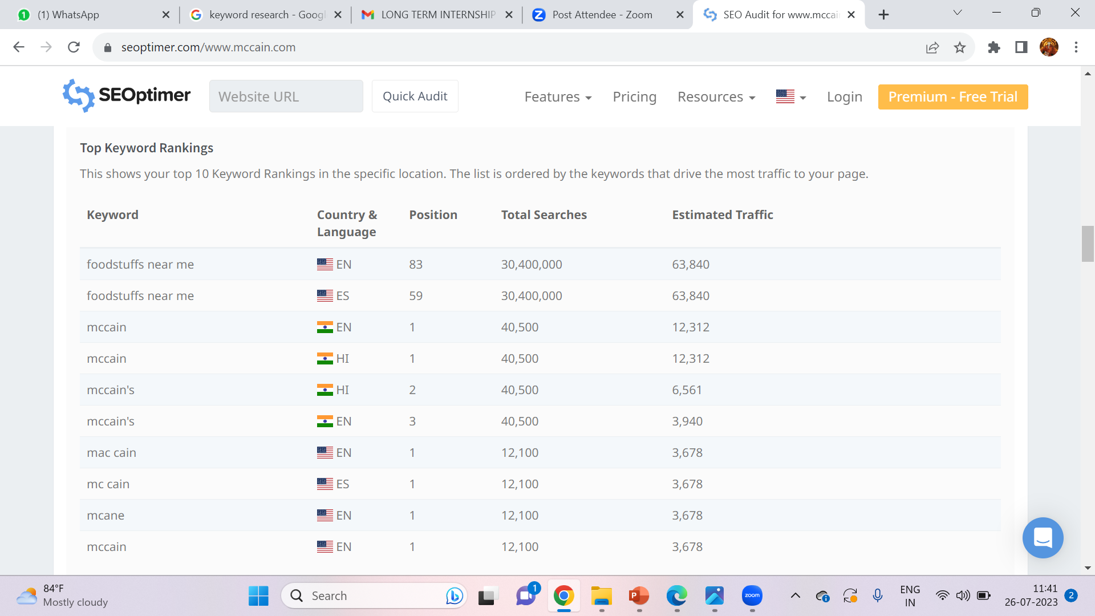
TOP KEYWORD RANKINGS :

Slide 15
KEYWORD RESEARCH :
Keyword research is a crucial process in digital marketing and search engine optimization (SEO) It involves identifying the specific words and phrases that people use when searching for information, products, or services on search engines like Google, Bing, or Yahoo.
KEYWORD RESEARCH FOR MCCAIN FOODS :
The following are the relevant keyword ideas , keywords ,organic traffic , brand overview , analyzing competitor keywords , objectives of keyword research , brainstorm seed keywords , long tail keywords of McCain brand that have been found after thorough research and filtering.

Slide 16
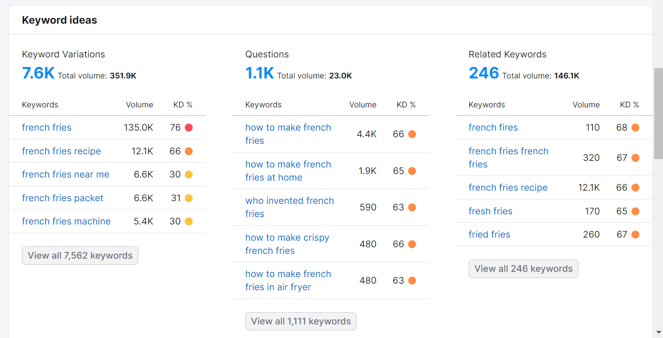
KEYWORD IDEAS :

Slide 17
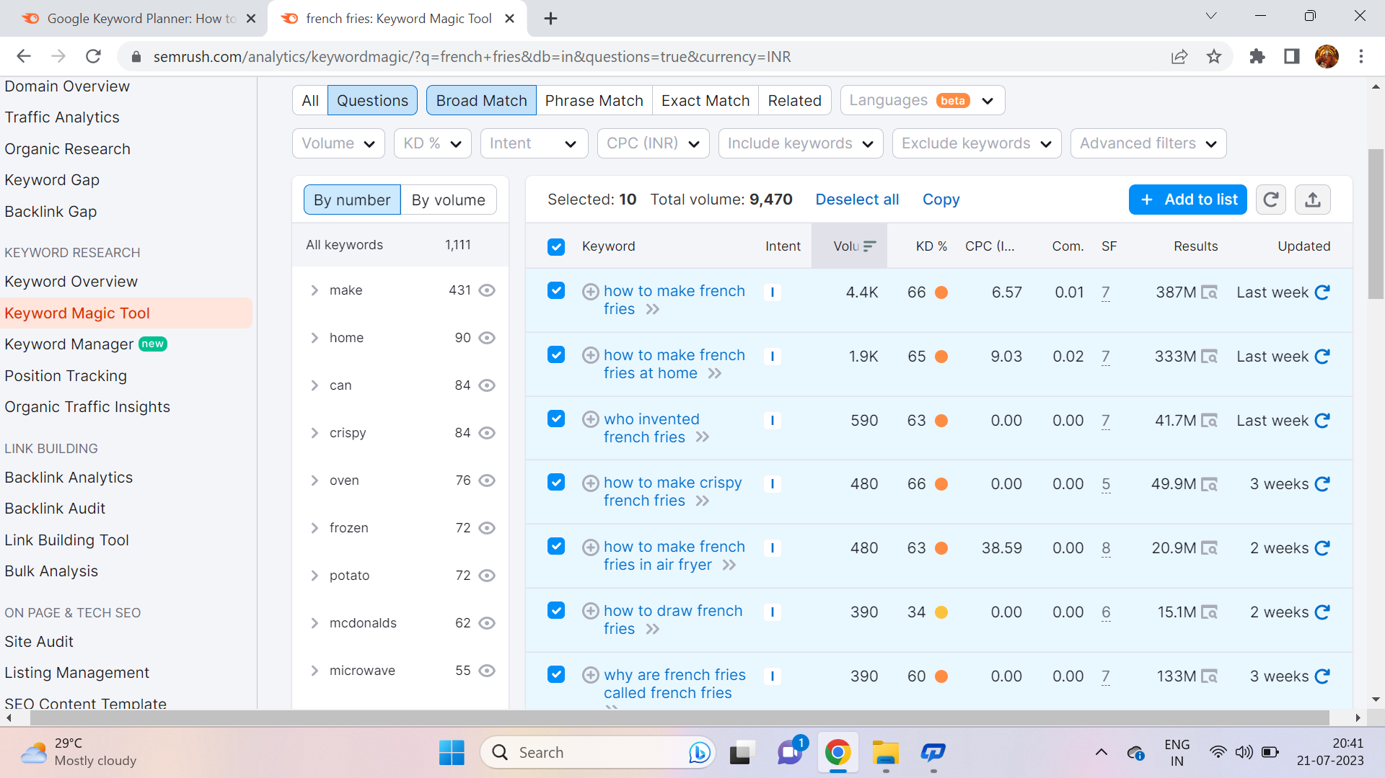
KEYWORD : FRENCH FRIES

Slide 18
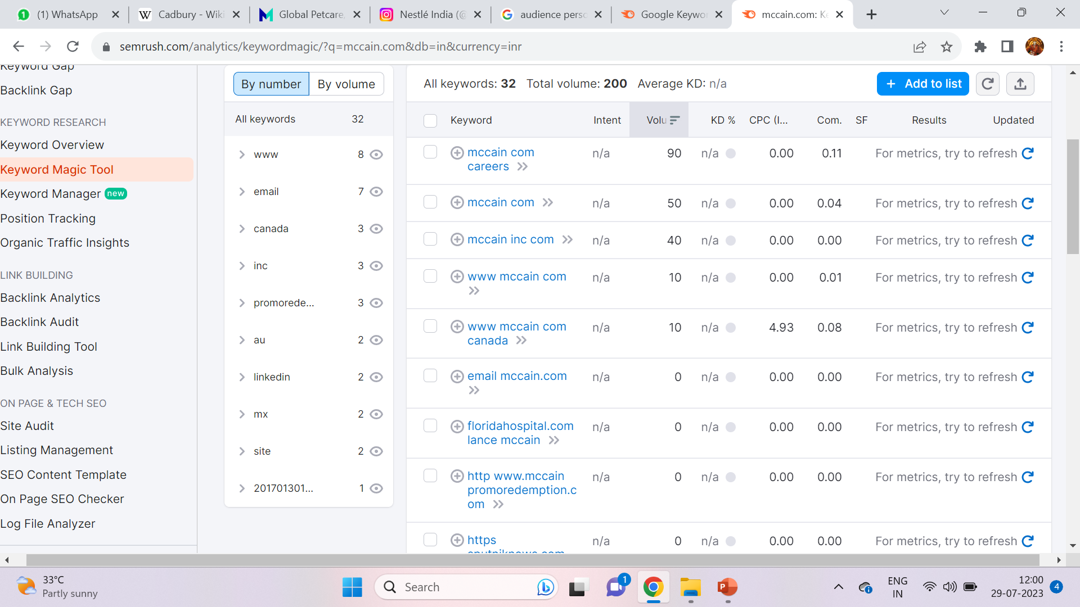
KEYWORD : MCCAIN

Slide 19
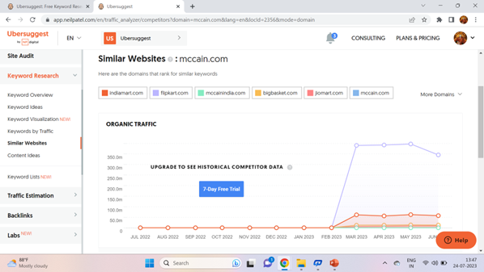
ORGANIC TRAFFIC :

Slide 20
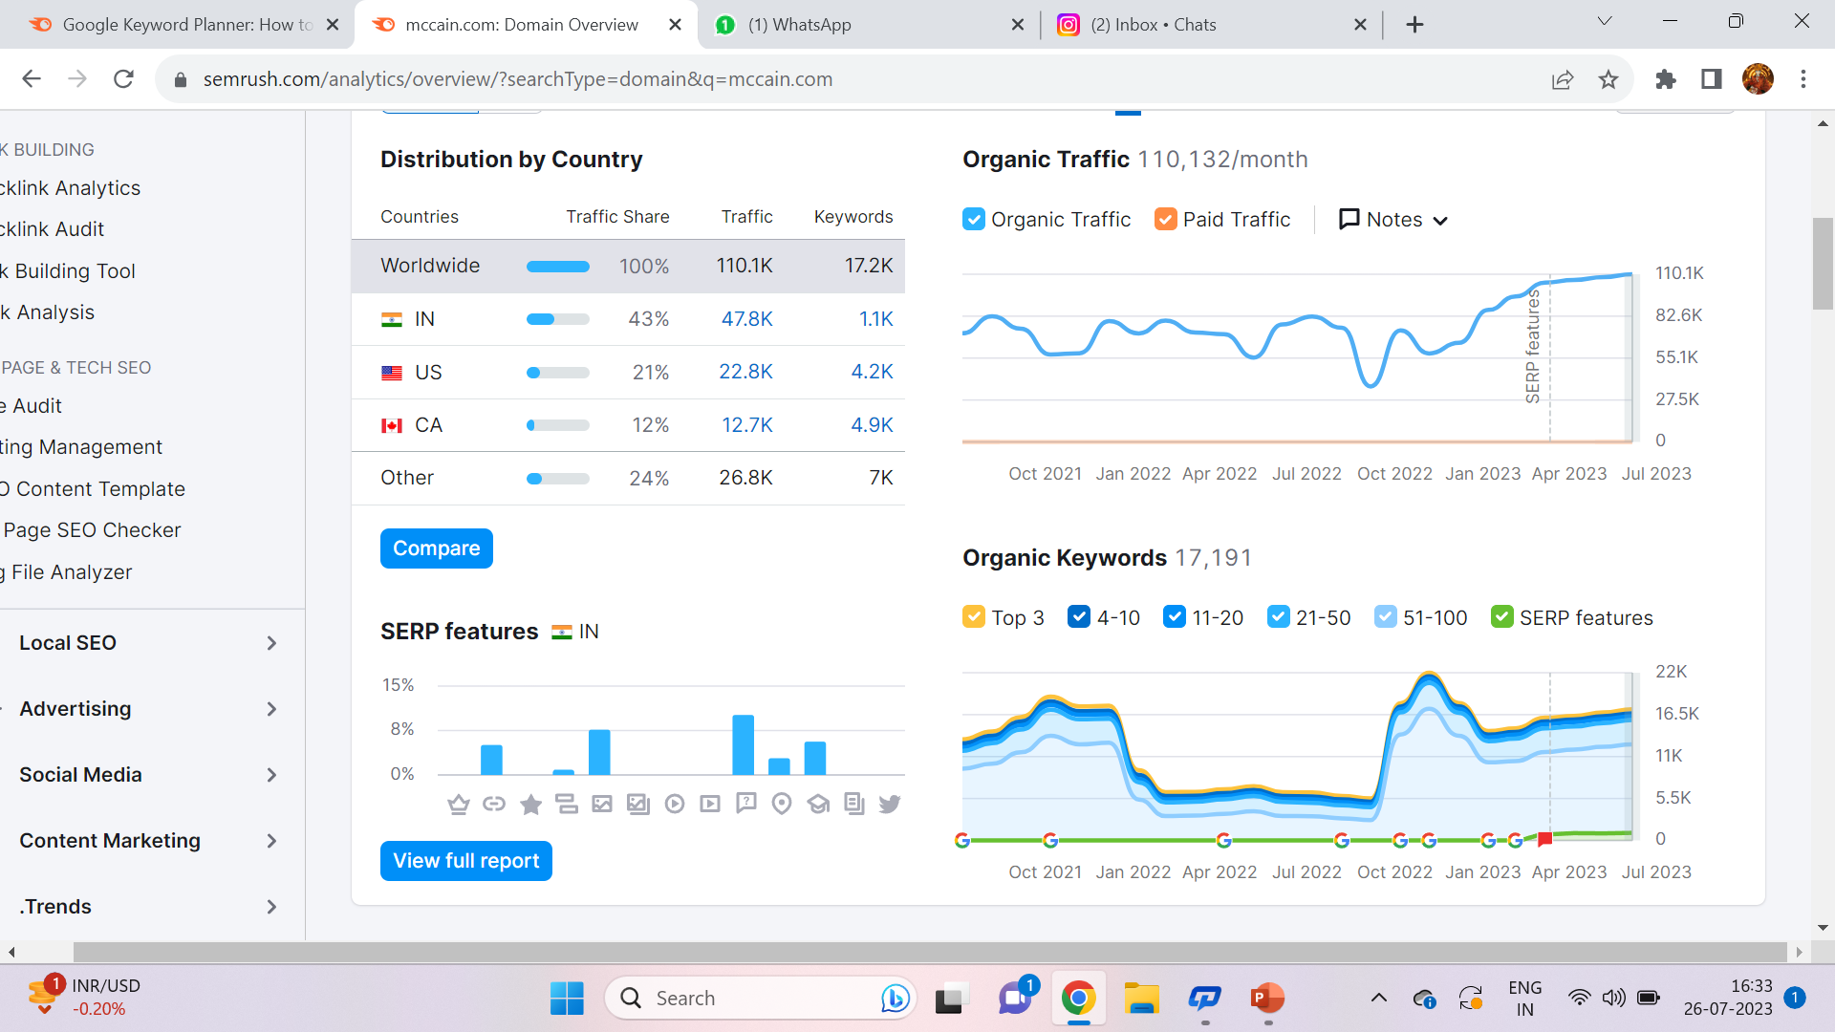
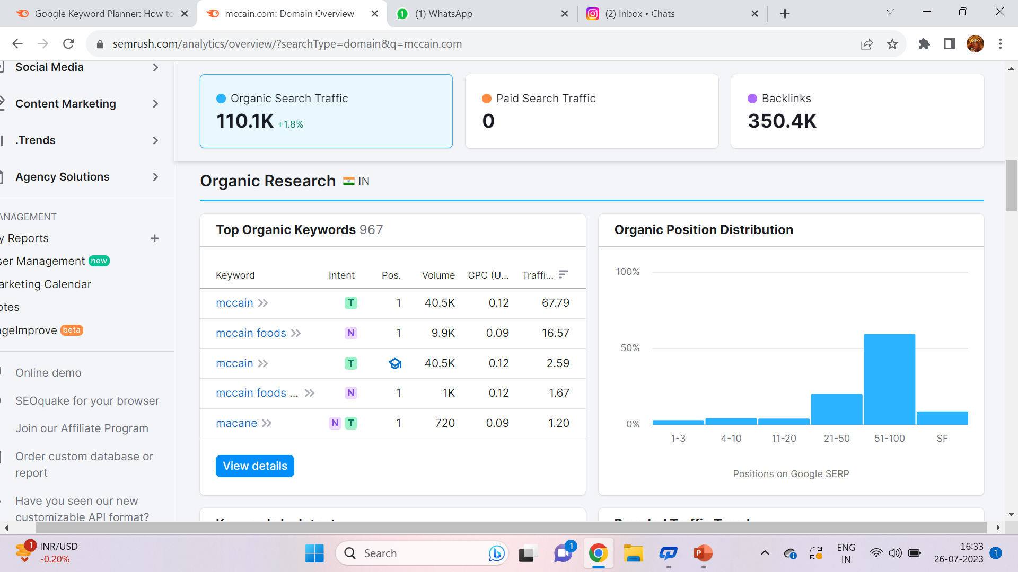
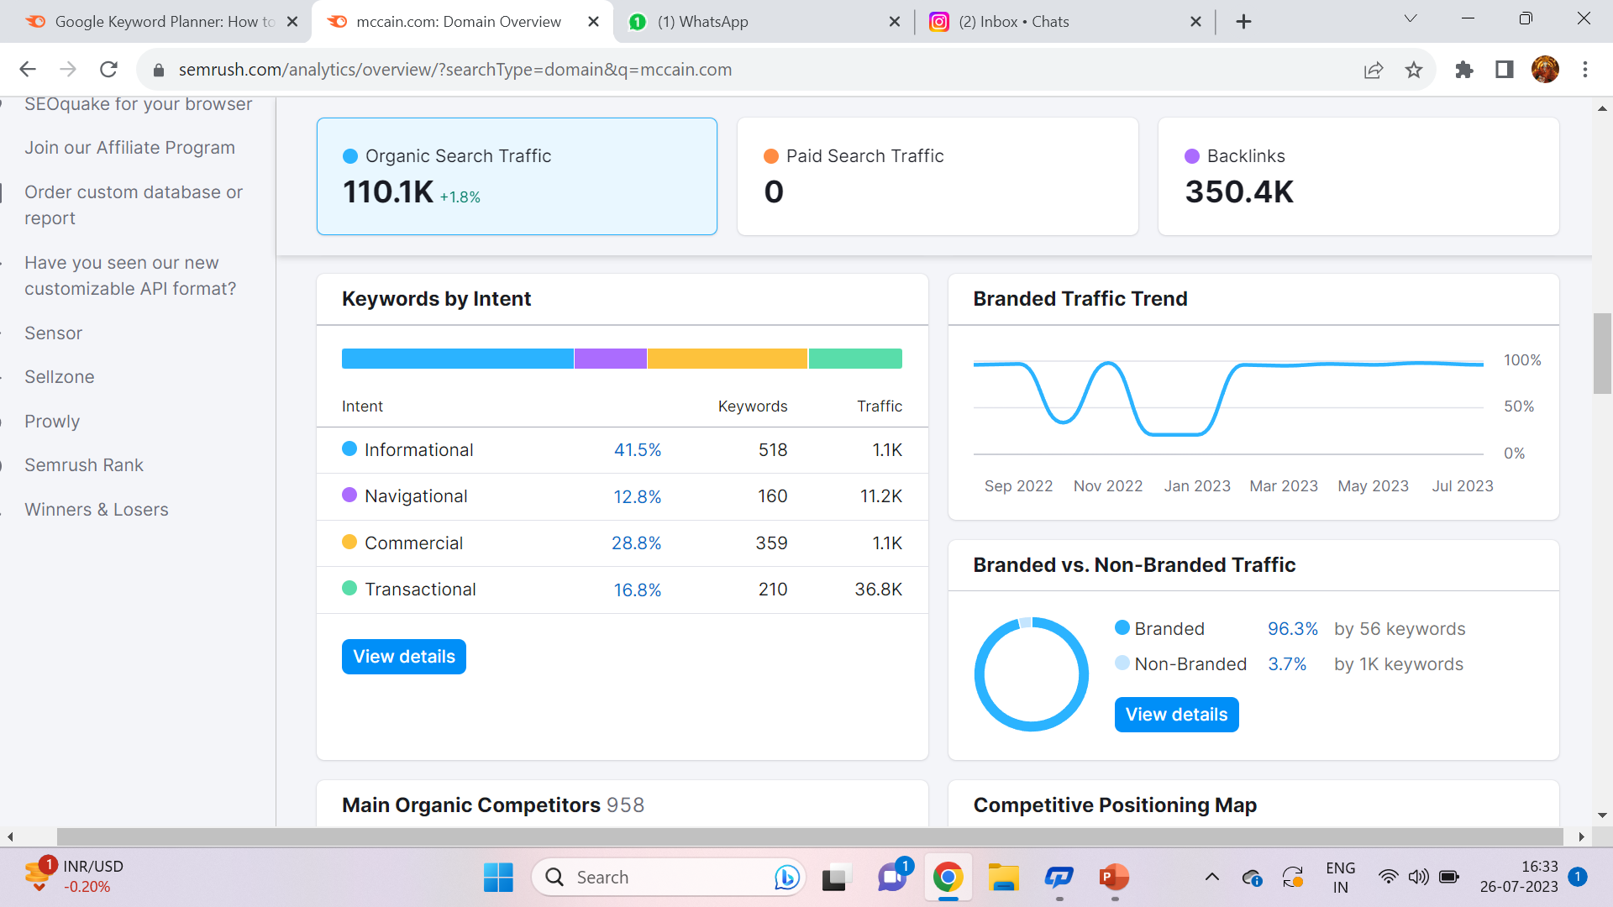
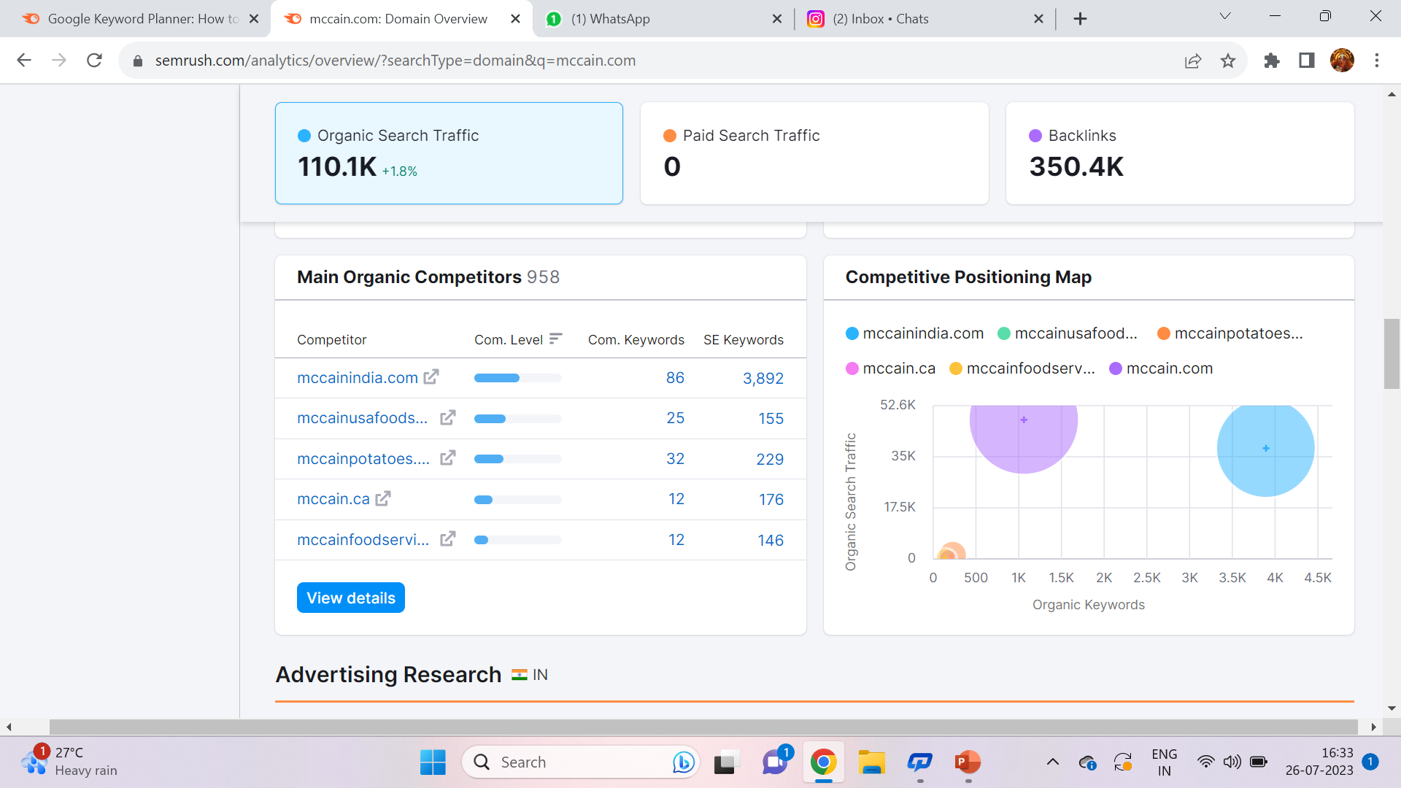
BRAND OVERVIEW :

Slide 21
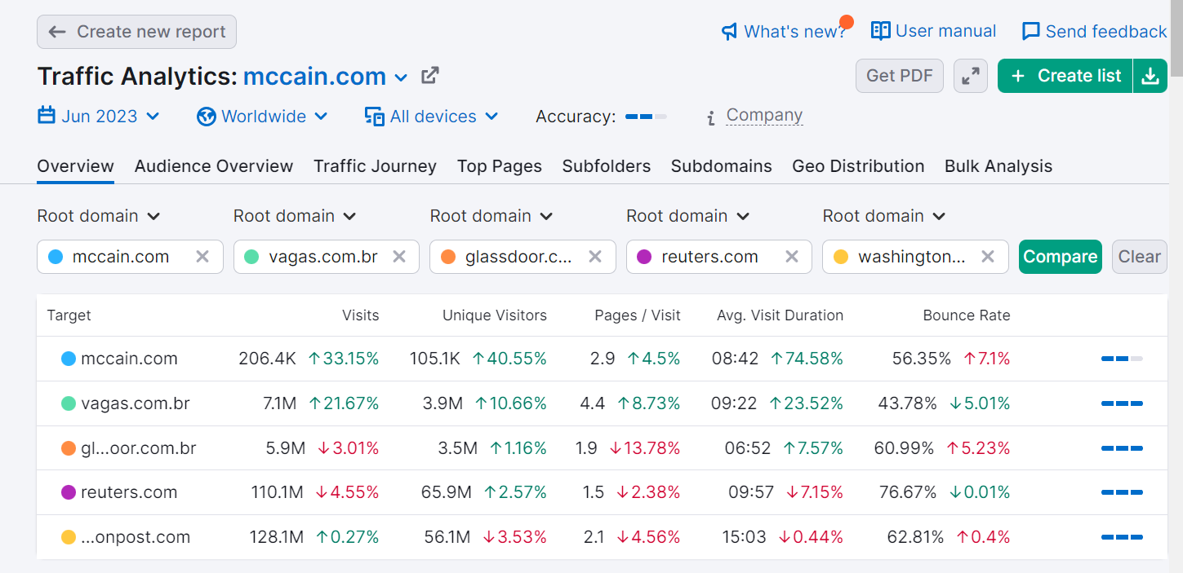
COMPETITOR KEYWORD :

Slide 22
OBJECTIVES OF KEYWORD RESEARCH :
To investigate the consumer perceptions and preferences towards delicious , healthy and planet-friendly products ,with a specific focus on McCain's existing product range .The research aims to understand the factors influencing giv
1 . | Improve Online Visibility
2. | Drive Organic Traffic
3. | Understand Customer Intent
4. | Optimize Product Descriptions
5. | Competitive Analysis
6. | Content Strategy
7. | Local Search Optimization
8. | PPC Advertising
9. | Improving organic search ranking
10. | Creating content

Slide 23
BRAINSTROM SEED KEYWORDS:
Here are some seed keywords for McCain, focusing on their frozen food products, especially frozen potatoes:
1. | Frozen potatoes
2. | French fries
3. | Hash browns
4. | Potato wedges
5. | Frozen food
6. | Ready-to-eat meals
7. | Frozen snacks
8. | McCain frozen products
9. | Frozen vegetable snacks
10. | Frozen potato snacks

Slide 24
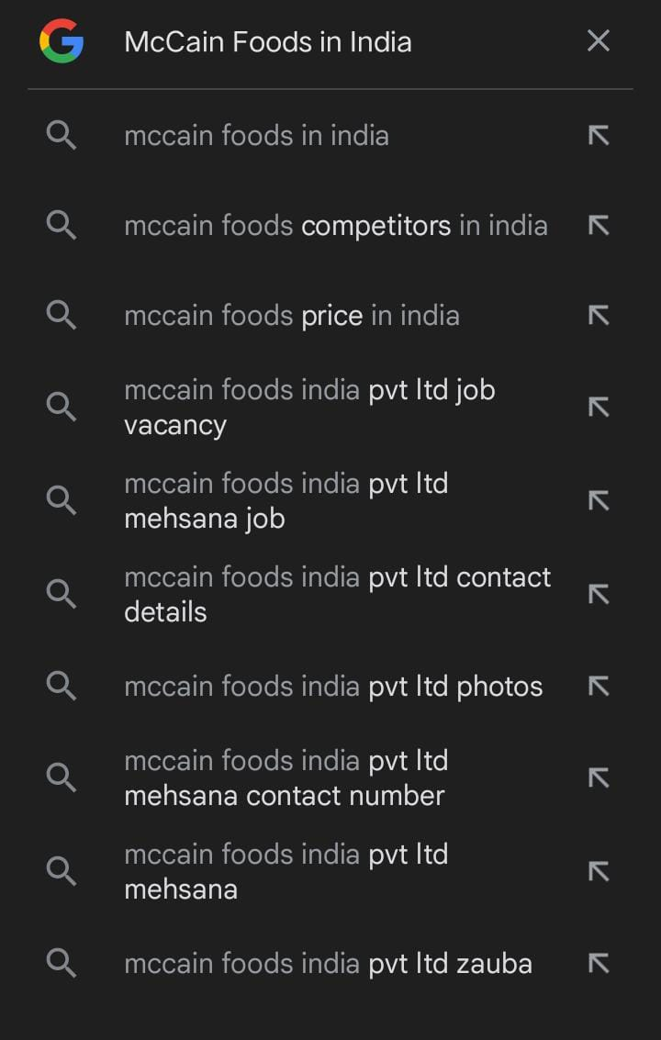
LONG TAIL KEYWORD :
A long tail keyword is a phrase that is generally made from three to five words with less competitors .
1 . | Buy McCain frozen potato wedges online
2. | Crispy McCain frozen hash browns recipe
3 | Best frozen French fries for baking
4 | Gluten-free frozen food options by McCain
5 | Where to find McCain frozen snacks near me
6 | Low-sodium frozen potato products by McCain
7 | Quick and easy frozen meal solutions for students
8 | McCain frozen finger foods for parties
9 | Healthy frozen vegetable snacks by McCain
10 | McCain frozen food delivery options
11 | Frozen food for toddlers by McCain
12 | Kid-friendly frozen potato sides

Slide 25
ON-PAGE OPTIMIZATION :
Meta tag optimization for https://www.mccainindia.com/
META TITLE : McCain: Home of Healthy French Fries
META DESCRIPTION :
Discover the ultimate combination of taste and health with McCain's delectable French fries. Savor the crispiness and mouthwatering flavor while knowing you're choosing a healthier option . Treat yourself to the delightful goodness of McCain's delicious and healthy French fries today!
META TAGS : McCain , French fries , healthy , crispiness , taste , delicious .
Content optimization for www.mccain.com

Slide 26
1.HOMEPAGE : Homepage is totally based on designs and information that we given to our website . Homepage always be shows the highlights of our brand with strong and unique meta titles and meta description along with clear and prominent CTA to lead visitors to explore actions like subscribe , learn more and shop now .
2.HIGH-QUALITY CONTENT:
Create engaging and informative content for each product category and individual products of McCains . Highlight the unique selling points, nutritional benefits, and all special features of the McCains.
3. URL STRUCTURE:
Optimize the URL structure of each page to make it user-friendly and search engine-friendly.
Example:
Optimized URL: www.mccainfoods.com/products/frozen-french-fries
Non-optimized URL: www.mccainfoods.com/p=1234

Slide 27
4. IMAGE ON OPTIMIZATION:
Optimize images used the website by adding alt text that describes the image using relevant keywords. This helps search engines understand the content of the images and improves accessibility for users with visual impairments
5. INTERNAL LINKING:
Implement a logical internal linking structure to connect related pages on the website. Internal links help search engines crawl and index the site more effectively, and they improve user navigation and engagement.
6. MOBILE-FRIENDLY DESIGN:
Ensure that the website is fully responsive and mobile-friendly. With the majority of internet users accessing websites from mobile devices, Google prioritizes mobile-friendly sites , tips and tricks in its search results.

Slide 28

7. PAGE LOADING SPEED:
Optimize the website's loading speed to enhance user experience and improve search engine rankings. Compress images, enable browser caching, and minimize server response time to reduce page load times.
8. SOCIAL SHARING BUTTONS:
Include social sharing buttons on product pages to encourage users to share their favorite products on social media platforms. Social signals can indirectly impact search engine rankings .

Slide 29
CHALLENGES IN SEO AND KEYWORD RESEARCH :
Too many tools , slow results .
LESSONS LEARNED :
Using SEOptimer , using SEMrush , analyze competitor keywords , website traffic , analyzing brand overview

Slide 30
PART 3: CONTENT IDEAS AND MARKETING STRATEGIES

Slide 31
CONTENT CALENDAR : AUGUST
SUNDAY | MONDAY | TUESDAY | WEDNESDAY | THURSDAY | FRIDAY | SATURDAY
 |  | 1 NATIONAL MOUNTAIN CLIMBING DAY | 2 | 3 | 4 | 5
6 FRIENDSHIP DAY | 7 NATIONAL HANDLOOM DAY | 8 QUIT INDIA MOVEMENT DAY | 9 NAGASAKI DAY | 10 WORLD LION DAY AND BIOFUEL DAY | 11 | 12 INTERNATIONAL YOUTH DAY
13 WORLD ORGAN DONATION DAY | 14 | 15 INDEPENDENCE DAY | 16 | 17 | 18 | 19 WORLD PHOTOGRAPHY DAY
20 WORLD MOSQUITO DAY | 21 | 22 | 23 | 24 | 25 | 26 INTERNATIONAL DOG DAY
27 | 28 | 29 NATIONAL SPORTS DAY | 30 RAKSHA BANDHAN | 31 SANSKRIT DIWAS

Slide 32
CONTENT IDEA :
McCain Foods has been a household name for decades, renowned for its premium frozen food products. But beyond the traditional favorites, there is a world of culinary possibilities waiting to be explored. In this content piece, we will take a journey through some innovative and delectable content ideas that McCain Foods could bring to its customers .
Emphasizing on health-conscious consumers, McCain could create a line of products with a "Healthy Twist . McCain could come up with a line of creative, interactive, and colorful frozen foods that cater specifically to children . With the combination of global inspiration ,health-conscious choices, family-fun meals, and creative pairings, McCain Foods can continue to delight its customers with innovative frozen food products. These content ideas aim to tap into diverse market segments, providing something for everyone while cementing McCain's position as a go-to brand for delicious and convenient culinary experiences.

Slide 33
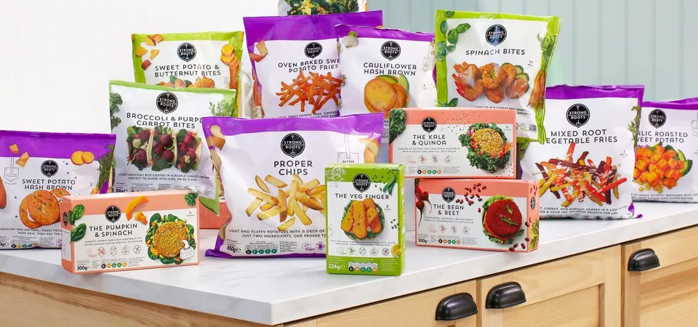
CONTENT IDEAS EXAMPLES :
Recipe Videos
Social Media Challenges
Health and Nutrition Tips
Throwback
Customer Testimonials
Seasonal Campaigns
Kids' Corner
Sustainable Sourcing
Global Cuisine Series
Behind the Scenes
Interactive Quizzes
Influencer Collaborations

Slide 34
MARKETING STRATEGIES :
BRAND POSITIONING:
McCain Foods has historically positioned itself as a premium brand offering high-quality frozen potato products. They focus on emphasizing the natural taste and quality of their products, leveraging their long-standing expertise in potato processing and freezing technology.
2. ADVERTISING CAMPAIGNS:
McCain Foods invests in advertising campaigns to create brand awareness and maintain a strong presence in the minds of consumers. These campaigns often highlight the convenience, taste, and versatility of their products.

Slide 35
3. DIGITAL MARKETING:
To reach a broader audience, McCain Foods utilizes digital marketing channels such as social media, online advertising, and influencer partnerships. Engaging content, recipe videos, and interactive campaigns are used to connect with consumers and encourage product usage.
4. IN-STORE PROMOTIONS:
Collaborating with retailers, McCain Foods runs in-store promotions, point-of-sale displays, and special offers to boost product visibility and encourage impulse purchases.
5. SPONSORSHIPS AND EVENTS:
McCain Foods may sponsor events or culinary shows to increase exposure and showcase the versatility of their products in various recipes.

Slide 36
6. HEALTH AND NUTRITION FOCUS:
With the increasing demand for healthier food options, McCain Foods may emphasize the nutritional value of their products, highlighting low-fat or trans-fat-free options and promoting responsible sourcing and sustainable practices.
7. CO-BRANDING AND PARTNERSHIPS:
McCain Foods may collaborate with other food brands or restaurants to create co-branded products or cross-promotional campaigns, leveraging the strength of both brands.
8. GLOBAL EXPANSION:
McCain Foods operates in various countries worldwide, and their marketing strategies may be tailored to suit the cultural preferences and tastes of each market while maintaining a consistent global brand image.

Slide 37
CHALLENGES IN SEO AND KEYWORD RESEARCH :
Understanding different buyer personas , Producing high – quality content
LESSONS LEARNED :
Creating content calendar , content ideas and marketing strategy .

Slide 38
PART 4: CONTENT CREATION AND CURATION

Slide 39
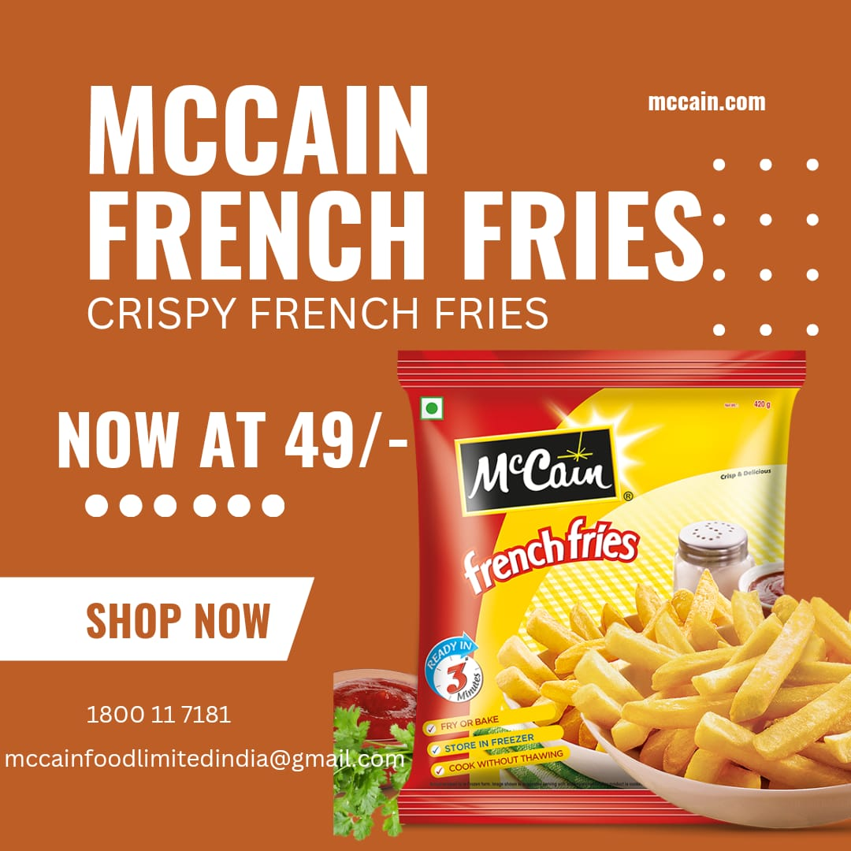
CONTENT CREATION
FORMAT – 1 : CREATIVE :
https://www.instagram.com/p/CvUdDSfxX1_/?igshid=MmU2YjMzNjRlOQ==
Aim : To improve website visibility
Date : 4th August 2023
Idea : To create a relatable and informative
content for attracting targeting audience .

Slide 40
FORMAT – 2 : BLOG ARTICLE :
Aim : Boost SEO and provide information about McCain’s new product.
Date : 4TH august 2023
Idea : McCain has launched new product cheese corn samosa and this blog
will cover the entire details about this new product .
Topic : McCain’s Cheese corn samosa .
ABOUT THE PRODUCT : Our McCain “Cheese Corn Filling” Mini Samosa is a combination of Cheese & Corn. Crunchy on the outside and gooey on the inside. This is an excellent snack for any time of day!
Store in Freezer
Cook without thawing
AVAILABLE ON :
amazon.com , bigbasket.com , dmart.com etc……

Slide 41
INGREDIENTS :
Refined Wheat Flour (Maida), Cheese (18.4%) (Cheese, Emulsifier {INS 331 (iii), INS 452 (i)}, Iodized Salt, Preservative {INS 200, INSS 234}, Water, Cotton Seed Oil, Corn (10.6%), Potato, Onion, Green Chilli (0.7%), Iodized Salt, Black Pepper. Contain Wheat and Milk My contain Soy, Mustard, Sesame and Nuts.
COOKING PROCESS :
Preheat oil
Take out the frozen pack
Fry for 3 min until light golden brown
Enjoy your favourite bowl of McCain
DISCLAIMER: Cooking and baking times may vary depending on the product and quantity.
Now there’s no more waiting to satisfy your craving just go for McCains .

Slide 42
NUTRITIONAL FACTS :
Nutritional Information* (Frozen Product) | Per 100 g | Per Serve % Contribution to RDA
Energy (kcal) | 294 | 5.9
Protein (g) | 7 | -
Carbohydrate (g) | 33.2 | -
Total Sugars (g) | 5.13 | -
Added Sugars (g) | 0 | 0
Total Fat (g) | 14.18 | 7.5
Saturated Fat (g) | Not more than 7.3 | 13.3
Trans Fat (g) | Not more than 0.07 | 1.4
Sodium (mg) | 358 | 7.2

Slide 43
PRODUCT HANDLING TIPS :
Any food product needs to have certain guidelines that help in keeping its freshness intact. Same goes for our products and to help you do just that here are a few tips and tricks that might help.
Make sure that when you buy our products that they are in good frozen condition soon as you get the product home, remember to put it into the freezer compartment as soon as possible
Transfer to the freezer compartment at the earliest.
Use straight from freezer – thawing not required.
Buy product in good frozen condition.
Return unused product back to the freezer at the earliest

Slide 44
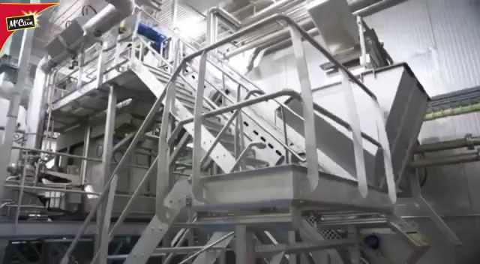
FORMAT – 3 : VIDEO :
https://www.instagram.com/reel/CvUXaLworv2/?igshid=MzRlODBiNWFlZA==
Aim : To attract clients/audience
Date : 4th August 2023
Idea : To create a video that helps to attract audience .

Slide 45
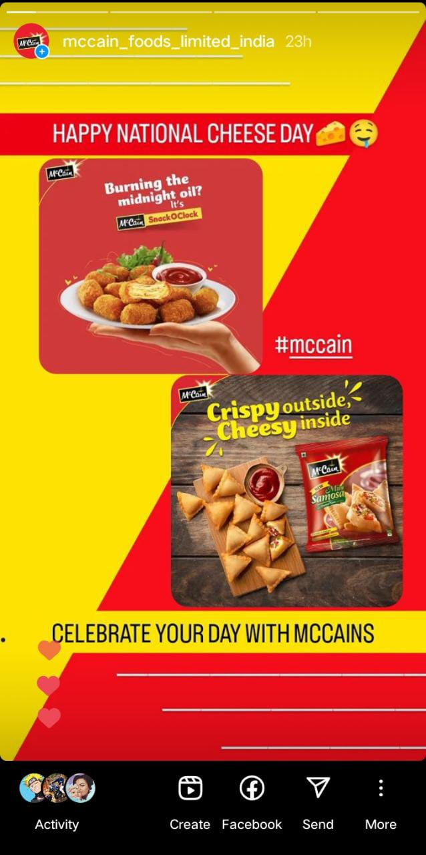
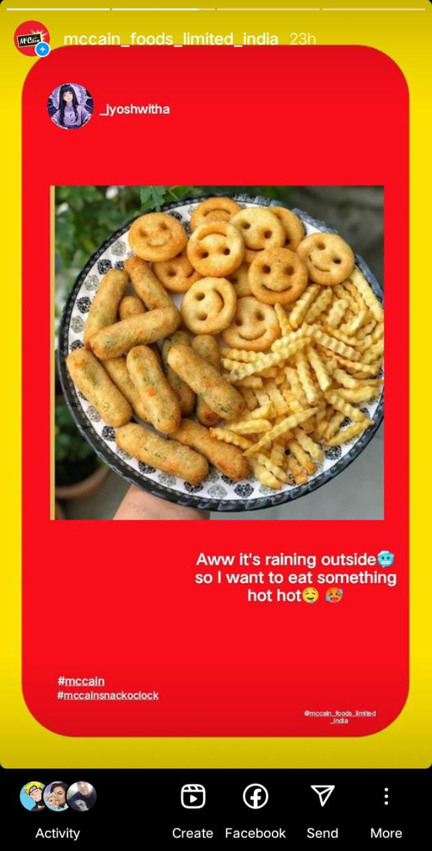
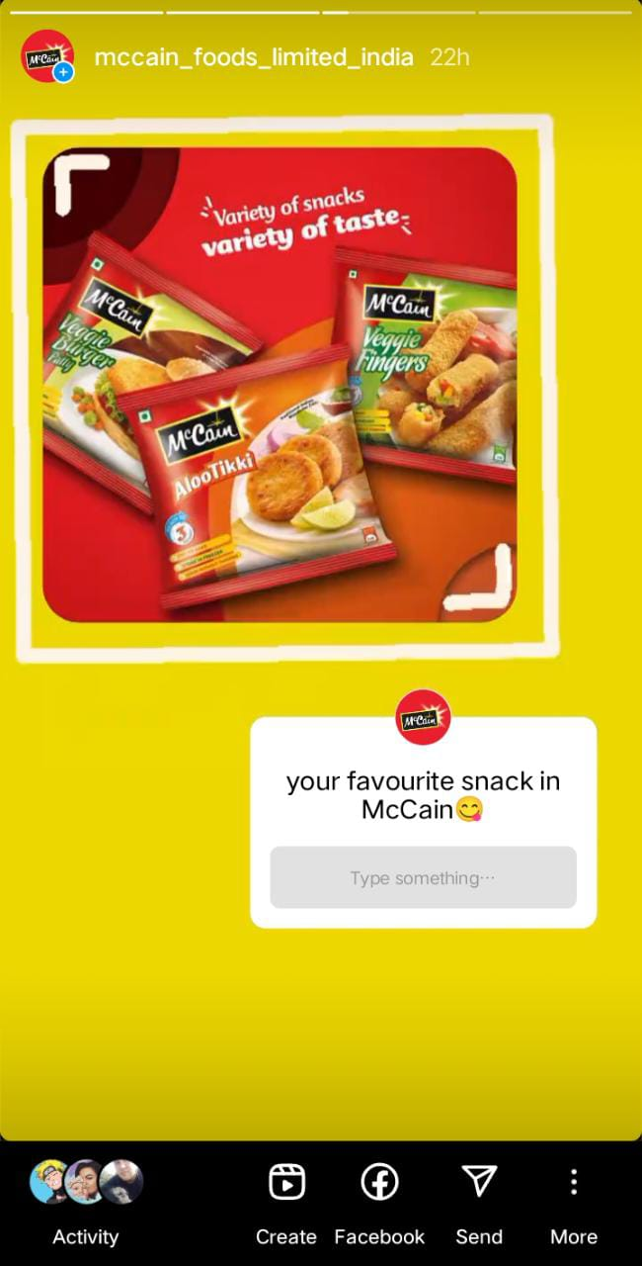
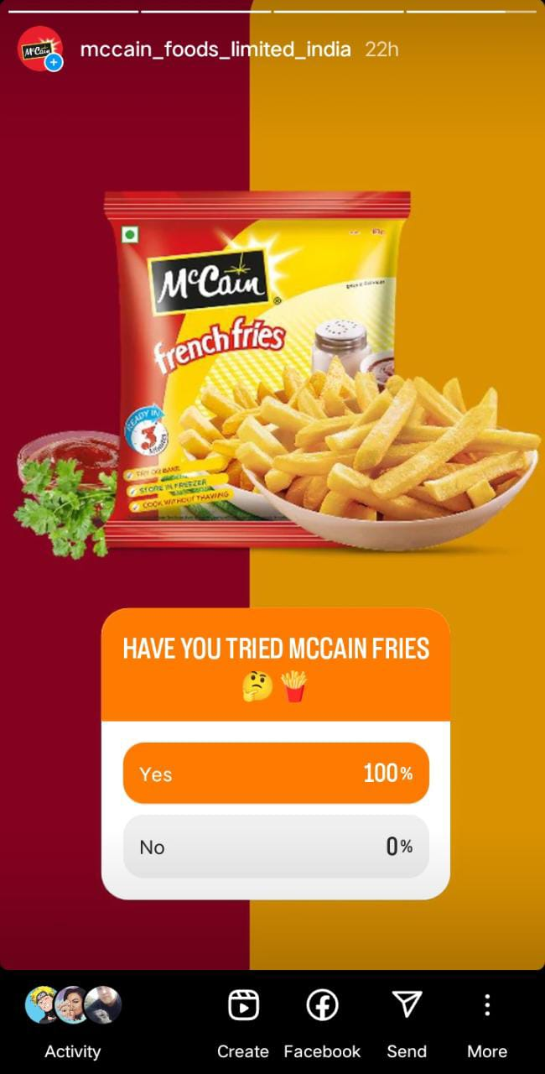
INSTAGRAM STORY :
https://instagram.com/mccain_foods_limited_india?igshid=MzRlODBiNWFlZA==
Views : 30
Likes : 26
Views : 27
Likes : 20
Views : 25
Likes : 15
Views : 35
Likes : 15

Slide 46

VIDEO : https://www.instagram.com/reel/CvOrosBqV9I/?igshid=MmU2YjMzNjRlOQ==

Slide 47
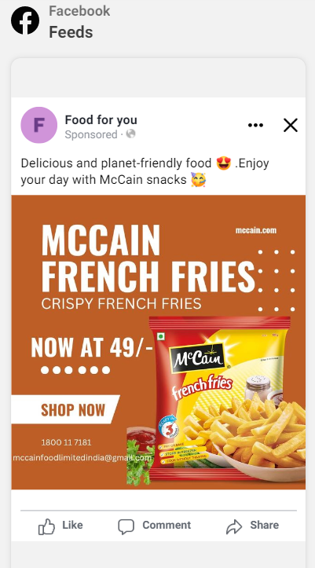
SOCIAL MEDIA AD CAMPAIGNS
BRAND AWARENESS CAMPAIGNS :
Campaign objective : Awareness
Location : India
Age : 15 – 55
Gender : All genders
Performance goal : Maximise reach of ads
Estimated audience size :248,300,000 - 292,100,000
Estimated daily reach : 21K-61K
Interests : Food and drink ,potato chip ,
snack food
Primary text : Delicious and planet-friendly food 😍 .Enjoy your day with McCain snacks 🥳

Slide 48
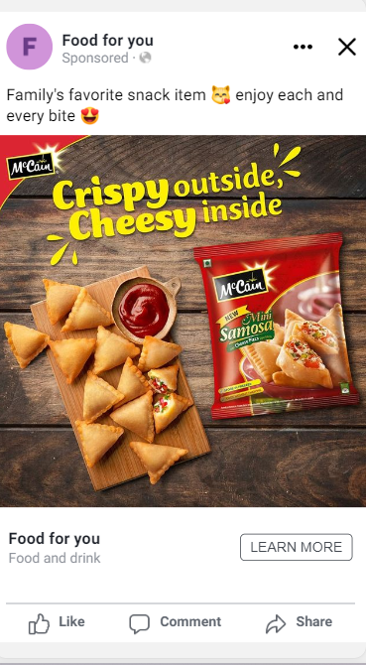
DRIVING WEBSITE TRAFFIC CAMPAIGN :
Campaign objective : Website traffic
Location : India
Age : 15 - 55
Gender : All genders
Performance goal : Maximize number of links clicks
Estimated audience size :248,100,000 - 291,900,000
Daily budget : 800rs
Estimated daily reach : 8.4K-24K
Estimated link reach : 233-673
Interests : Food and drink , snack food
Primary text : Family's favorite snack item 😽 enjoy each and every bite 😍

Slide 49
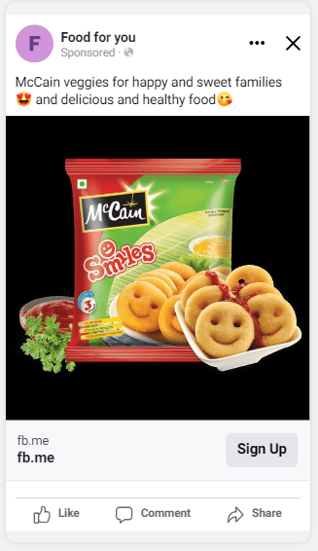
LEAD GENERATION CAMPAIGN :
Targeting :-
Campaign objective : Leads
Location : India
Age : 15 – 55
Gender : All genders
Performance goal : Maximize reach of ads
Estimated audience size :435,200,000 - 512,000,000
Daily budget : 800rs
Estimated daily reach : 3.6K-10K
Estimated leads :14-40
Interests : Food and drink ,snack food
Primary text :McCain veggies for happy and sweet families 😍 and delicious and healthy food😘

Slide 50
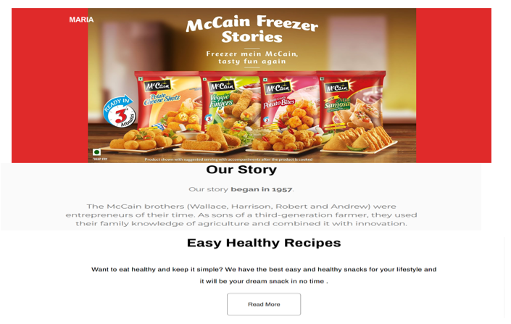
EMAIL AD CAMPAIGN
BRAND AWARENESS : https://mailchi.mp/a1f3ef73095d/french-fries

Slide 51
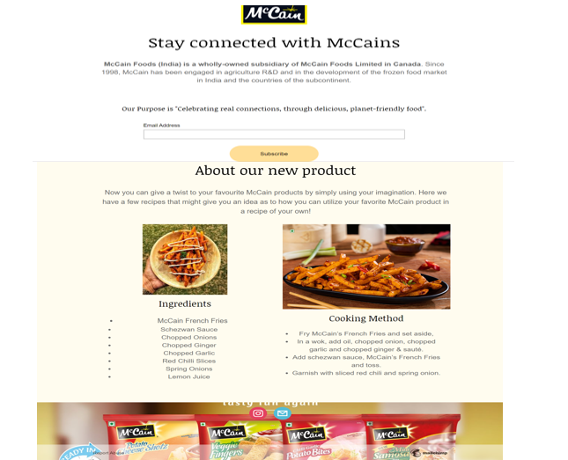
LEAD GENERATION : https://mailchi.mp/256c7a6d53cc/mccain

Slide 52
CHALLENGES IN CONTENT CREATION :
Consistency , audience relevance , promotion and adaptation .
LESSONS LEARNED :
Creating content calendar , conduct audience research , focus on quality ,diversity formats , promote effectively , analyze feedback , creating ad campaigns .

Slide 53
THE END

